Slide 1
“But you don’t look like a Librarian”:
Reflections of an Early Career Professional on Identity and Professional Practice
Kevin Tanner
kevin.tanner@sait.ca
Instructional Librarian, Southern Alberta Institute of Technology

Slide 2


Slide 3


Slide 4
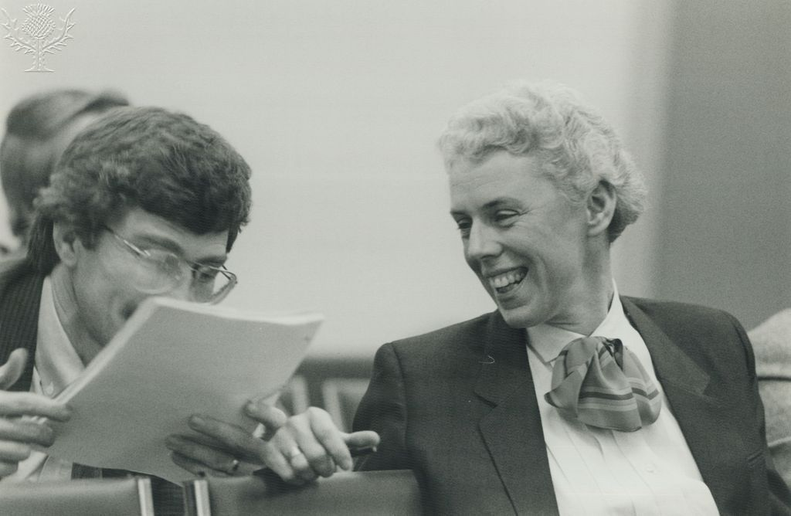
Two law students presumably laughing at me/my resume
“Kevin is such a silly chap for thinking he could be one of us”

Slide 5
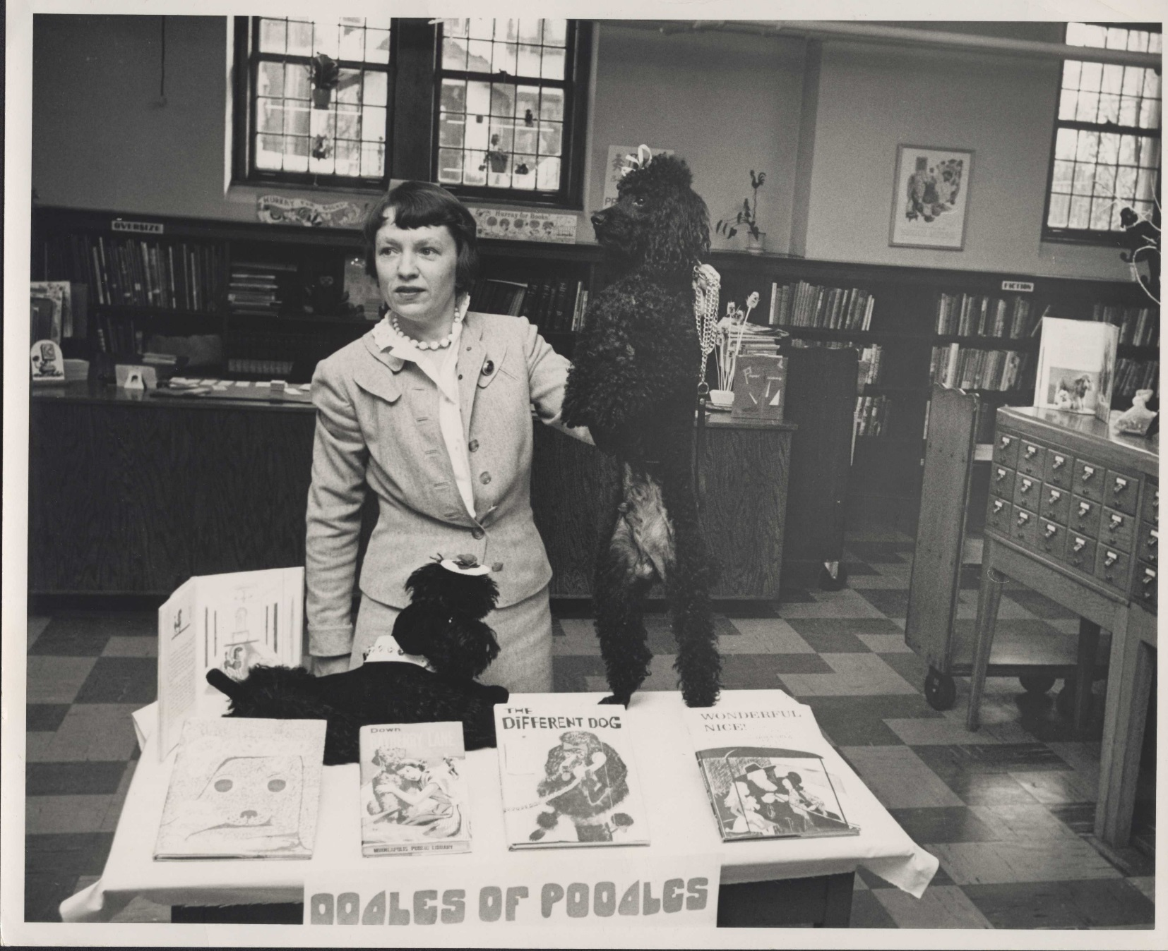

Slide 6
Professional Identity
What is Professional Identity? Why should we care about it?

Slide 7
Professional Identity: Definition
“One’s professional self-concept based on attributes, beliefs, values, motives, and experiences” (Slay & Smith, 2011)
Distinct from image
  Image is how other’s view a profession
  Identity is a “description of representation of the self within specific social practices” (Hicks, 2016)
Slightly different for everyone, deterministic

Slide 8
Crisis of Professionalism in Law: The Problem
Values are not heterogeneous
Loss of trust in lawyers
The “postmodern” professional lawyer faces struggle from the outside and inside (Pfadenhauer, 2006).

Slide 9
Crisis of Professionalism in Law: The Solution
Increased focused on professional identity
Identity construction happens in law schools - not direct instruction but integrated within the curriculum (Thomson, 2014)
Research focus on professional identity begins on-going scholarly conversation

Slide 10
Professionalism of Librarians
Identity less studied
The more we critically reflect, the more we critically construct
Crisis of professionalism ongoing, but not quite a crisis(?)

Slide 11
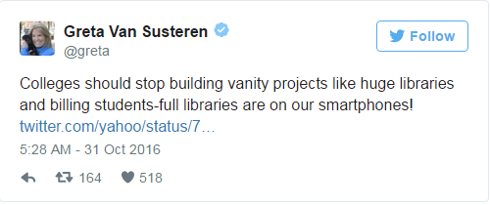

Slide 12
Crisis of Professionalism in Librarianship:
The Problems?
Work is changing, varied
Library School instills values, ALA and others write them down, we reinforce them through professional practice and our own narratives
Values are being called into question (perhaps also a solution)
Identity affects image, for better or worse

Slide 13
Crisis of Professionalism in Librarianship:
Potential Solutions
Critically reflect on our identities; separately and collectively
Curate your identity based upon who you want to be as a professional
Increase focus on professional identity as an area of study and in school

Slide 14
“But Kevin, You Still Don’t Look Like a Librarian”
My own identity shaped by others
Grounded in professional philosophy, values
Purposefully articulated and critically constructed

Slide 15
Thank you!
Questions?!?!

Slide 16
References
Hicks, Deborah. (2016). “Advocating for Librarianship: The Discourses of Advocacy and Service in the Professional Identities of Librarians.” Library Trends, 64(3): 615–640.
Pfadenhauer, M. (2006). Crisis or decline? Problems of legitimation and loss of trust in modern professionalism. Current sociology, 54(4), 565-578.
Slay, H. S., & Smith, D. A. (2011). Professional identity construction: Using narrative to understand the negotiation of professional and stigmatized cultural identities. Human Relations, 64(1), 85-107.
Thomson, D. I. (2014). Teaching Formation of Professional Identity. Regent UL Rev., 27, 303.

