Slide 1

Budgeting with Stats, Stats & more Stats!

Slide 2
E-book Purchase Models
Subscription packages (ebrary’s Academic Complete, Books 24x7, Safari, Access Engineering, Knovel)
E-books in perpetuity (ebrary, McGraw-Hill)
DDA (Demand-Driven Acquisitions) through Yankee Book Peddler

Slide 3
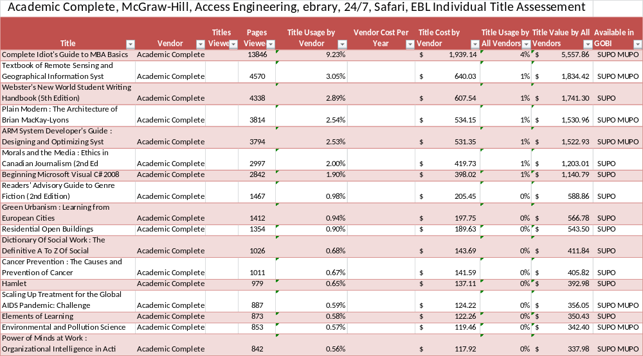
Stats

Slide 4
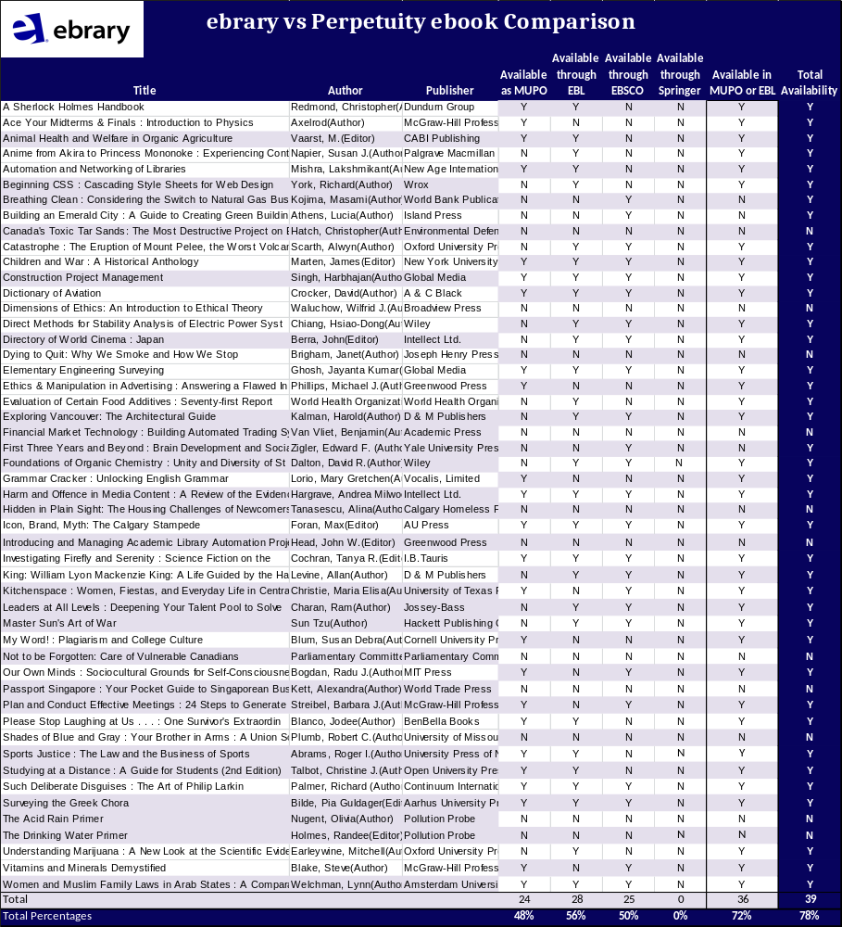
…more Stats

Slide 5
Usage by Title
 | Titles | Titles Viewed | % Titles Viewed | Title Visits | Title Visits/Title | Vendor Cost | Cost/Title | Cost/Title Viewed
ebrary’s Academic Complete | 115795 | 3403 | 3% | 10346 | 0.09 | n/a | $ 0.18 | $ 6.17
Books 24x7 | 20289 | 1581 | 8% | 6677 | 0.33 | n/a | $ 1.58 | $ 20.24
Safari | 4272 | 1156 | 27% | 6222 | 1.46 | n/a | $ 6.32 | $ 23.36
Access Engineering | 330 | 170 | 52% | 7046 | 21.35 | n/a | $ 24.53 | $ 47.62
Knovel | 3484 | 1842 | 53% | 2410 | 0.69 | n/a | $ 2.48 | $ 4.68
McGraw-Hill (in Perp.) | 264 | 95 | 36% | 1606 | 6.08 | n/a | $ 20.20 | $ 56.15
ebrary (in Perp.) | 1190 | 363 | 31% | 1375 | 1.16 | n/a | $ 25.80 | $ 84.59
EBL/DDA | 735 | 735 | 100% | 939 | 1.28 | n/a | $ 3.83 | $ 3.83
Total | 146359 | 9345 | 6% | 36621 | 0.25 | $ 135,577.00 | $ 0.93 | $ 14.51

Slide 6
Usage by Page Viewed
 | Titles | Pages Viewed | Pages Viewed/Title | Vendor Cost | Cost/Page | Variance | Weighted Cost/Page
ebrary’s Academic Complete | 115795 | 149946 | 1.29 | n/a | $ 0.14 | 298.21 | $ 0.42
Books 24x7 | 20289 | 58400 | 2.88 | n/a | $ 0.55 | 288.93 | $ 1.58
Safari | 4272 | 53868 | 12.61 | n/a | $ 0.50 | 158.87 | $ 0.80
Access Engineering | 330 | 2660 | 8.06 | n/a | $ 3.04 | 22.04 | $ 0.67
Knovel | 3484 | 8625 | 2.48 | n/a | $ 1.06
McGraw-Hill (in Perp.) | 264 | 29805 | 112.90 | n/a | $ 0.18 | 1080.83 | $ 1.93
ebrary (in Perp.) | 1190 | 23910 | 20.09 | n/a | $ 1.28 | 170.27 | $ 2.19
EBL/DDA | 735 | 19167 | 26.08 | n/a | $ 0.15 | 38.26 | $ 0.15
Total | 146359 | 346381 | 2.37 | $ 135,577.00 | $ 0.39 | 293.91 | $ 1.15

Slide 7
Budget Savings
Current e-book Expenditures: $135,577.00
If we replaced Academic Complete,
Safari, 24x7 with DDA: $78,188.10
Total potential savings: $57,388.90
This money is now only coming from the ‘Capital’ budget

